Slide 1
Drake in R
Matthew Pettis

Slide 2
Who am I?
Matt Pettis, Data Scientist at Trane
Heavy R User

Slide 3

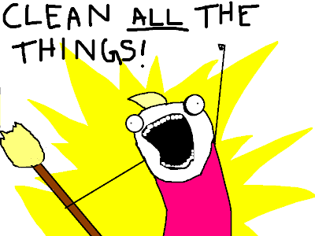
Notes:
… you start with a pile of stuff
… with a lot of effort, you clean it up and make sense of it
…

Slide 4
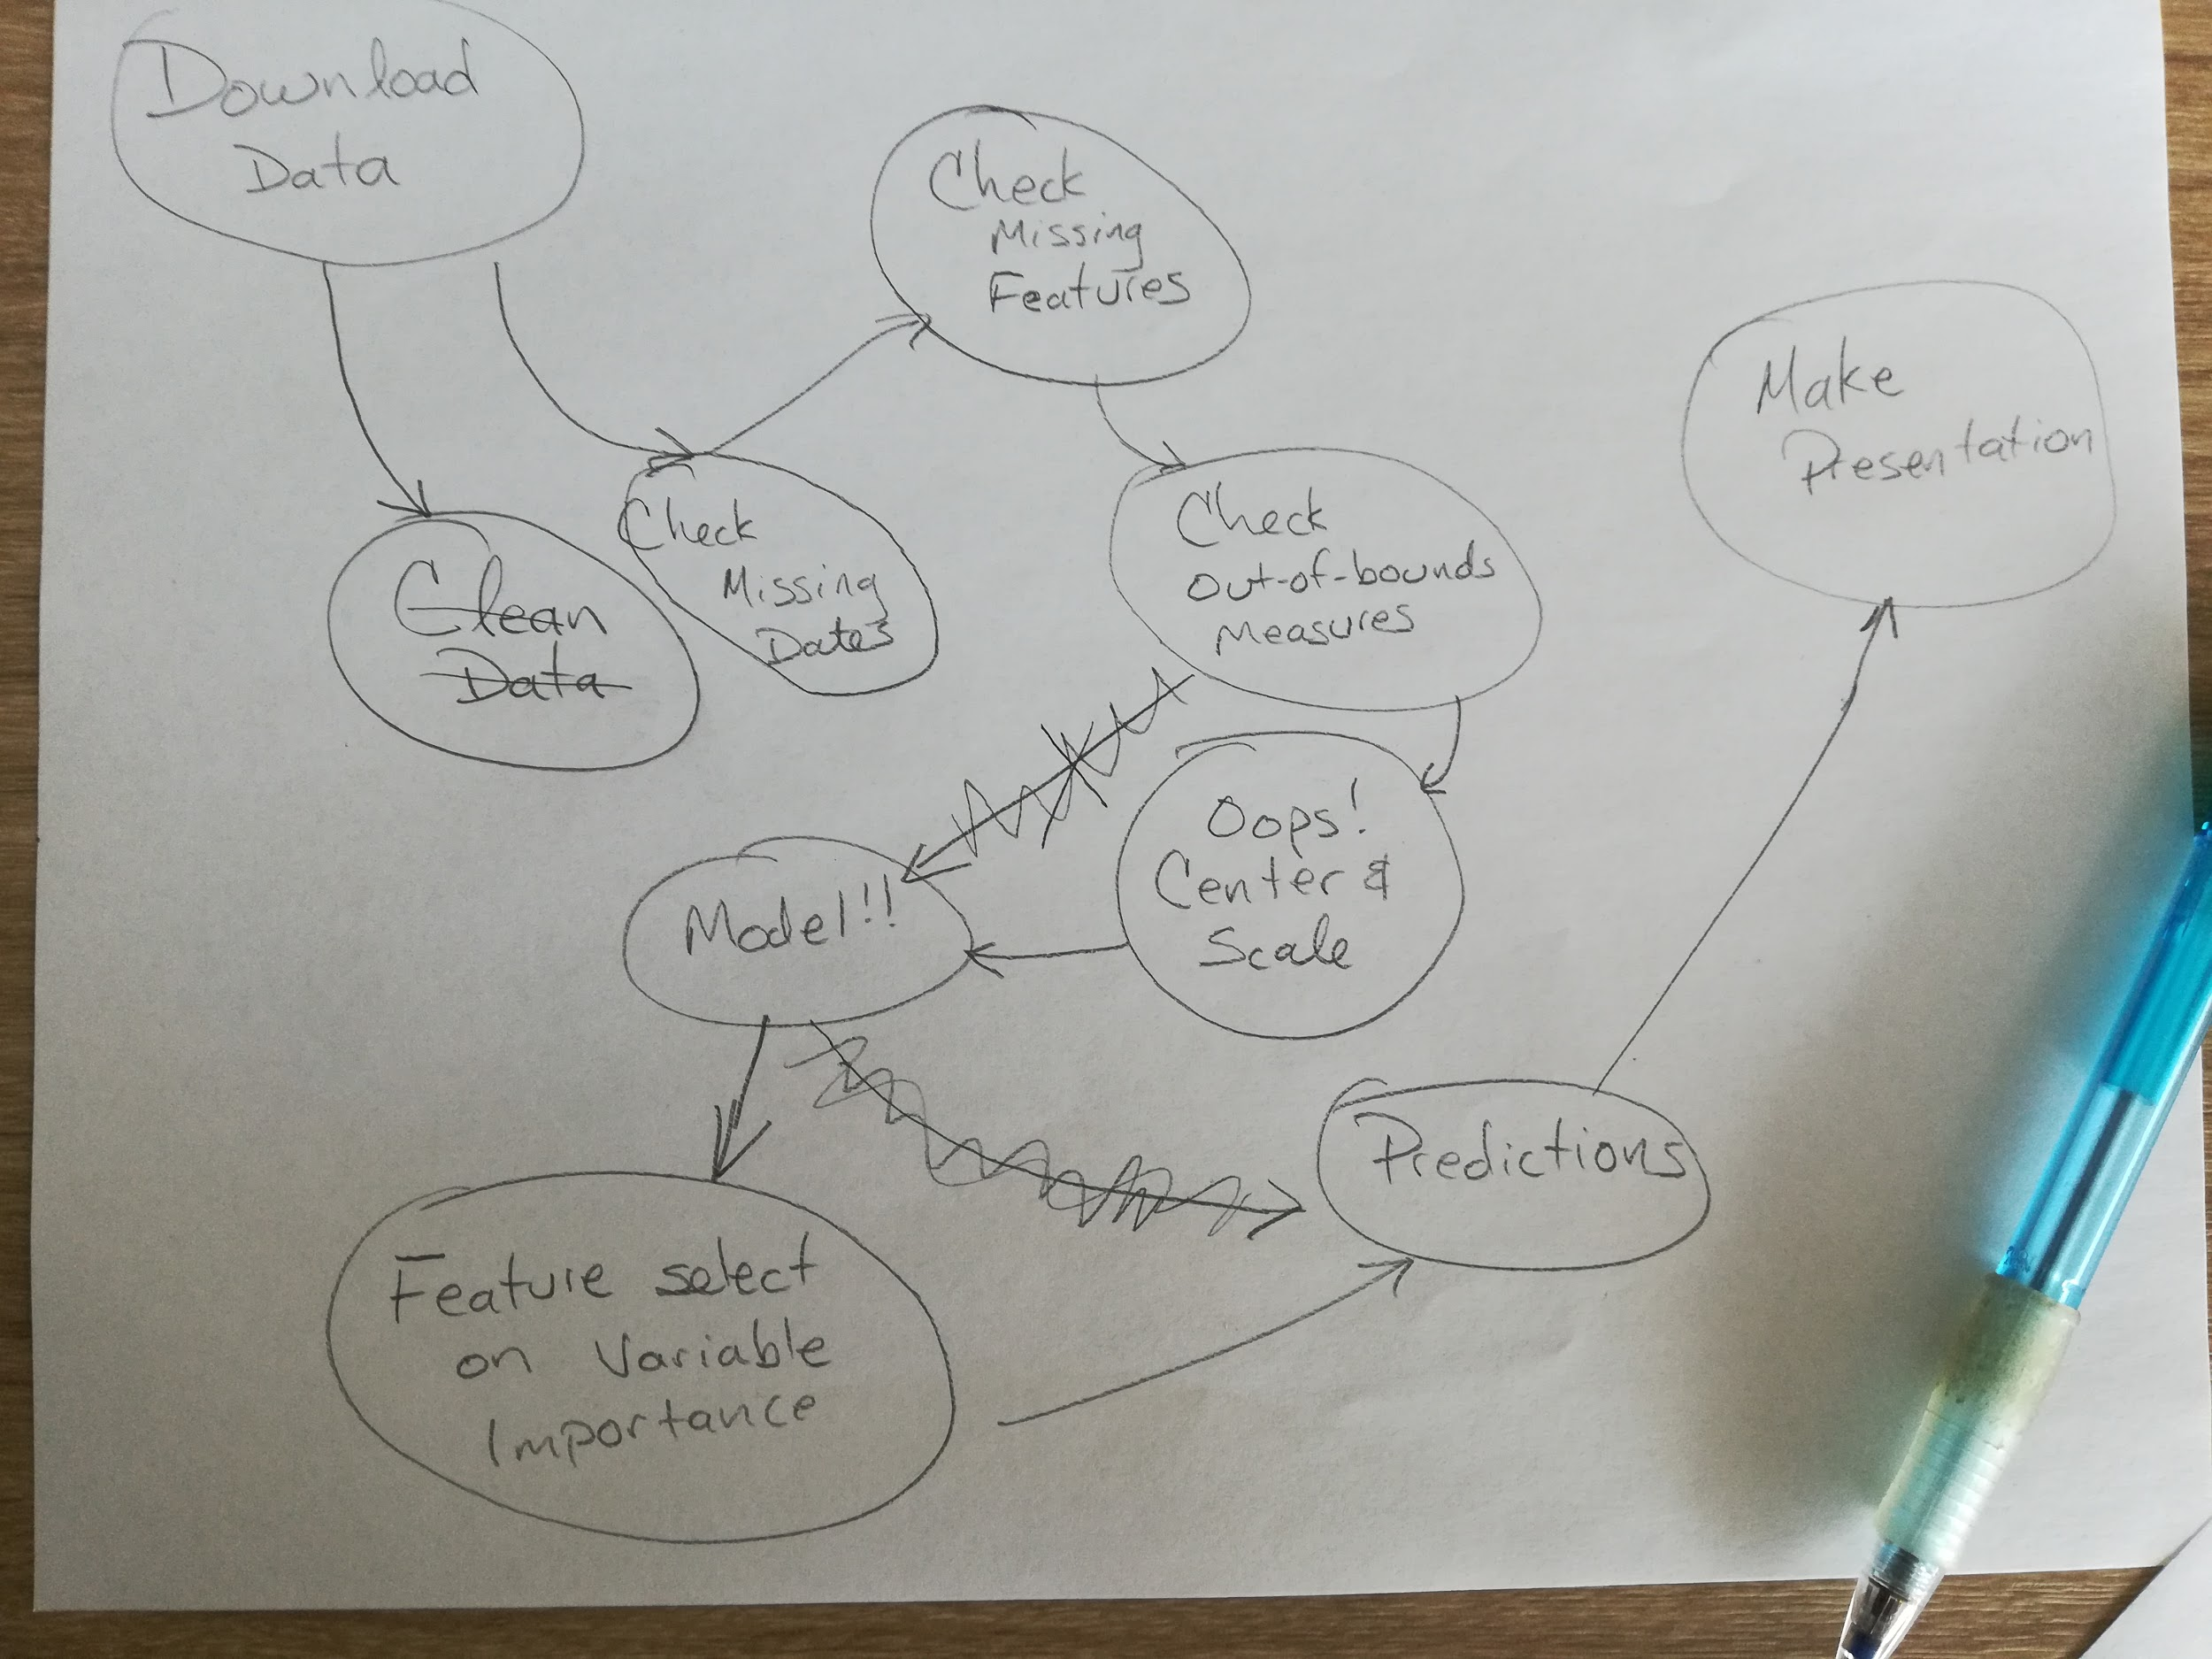

Slide 6
irinzn@SPA-TL-1YG9SN2 ~/Documents/personal/tcrug-talks/drake_2019-10-17/example-flow
$ ll
total 0
-rw-r--r--+ 1 irinzn Domain Users 0 Oct 9 13:58 100-query-raw-data.R
-rw-r--r--+ 1 irinzn Domain Users 0 Oct 9 13:58 200-check-missing-dates.R
-rw-r--r--+ 1 irinzn Domain Users 0 Oct 9 13:58 210-check-missing-features.R
-rw-r--r--+ 1 irinzn Domain Users 0 Oct 9 13:58 230-check-out-of-bounds.R
-rw-r--r--+ 1 irinzn Domain Users 0 Oct 9 13:58 300-test-train-split.R
-rw-r--r--+ 1 irinzn Domain Users 0 Oct 9 13:58 400-clean-impute.R
-rw-r--r--+ 1 irinzn Domain Users 0 Oct 9 13:58 410-center-and-scale.R
-rw-r--r--+ 1 irinzn Domain Users 0 Oct 9 13:58 500-feature-selection.R
-rw-r--r--+ 1 irinzn Domain Users 0 Oct 9 13:58 600-model-creation.R
-rw-r--r--+ 1 irinzn Domain Users 0 Oct 9 13:58 610-model-evaluation.R
Notes:
Since these sort lexicograpically, you can write a script that easily executes all scripts in a directory in lexicographically.

Slide 7
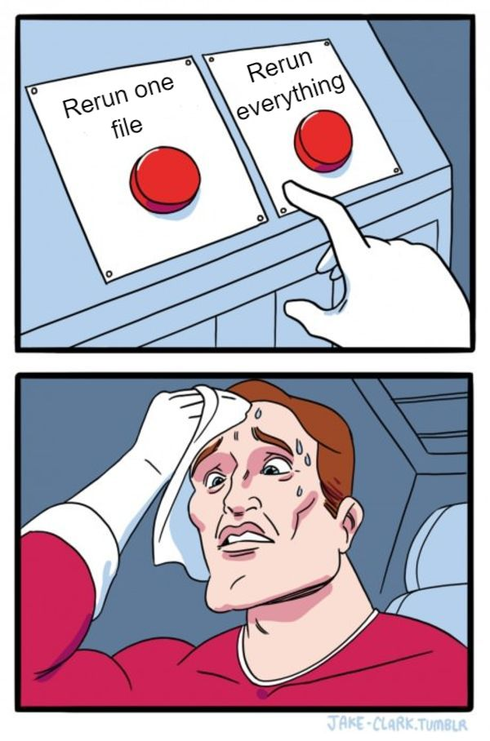

Slide 8
Full vs. Partial Re-runs
Full runs are usually unnecessary and time-consuming.
Sometimes they are infeasible.
Notes:
Ole Lena joke, painting stripe down middle of highway.

Slide 9
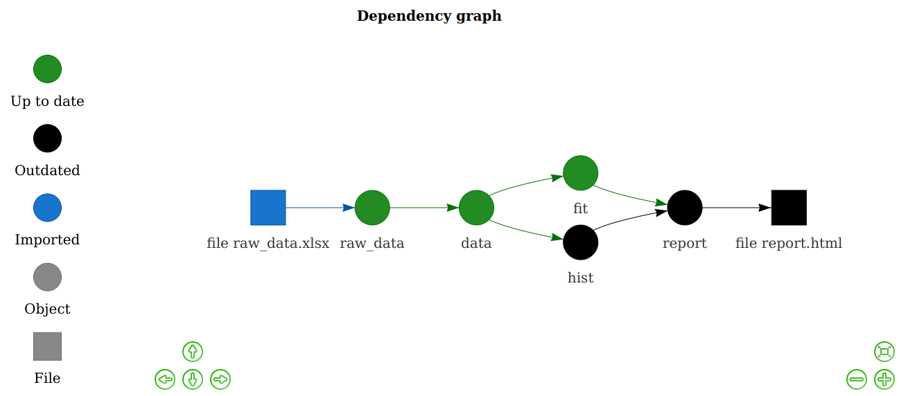
Enter {drake}
Notes:
… one of many descendants of `make`
… recognizes that processes are a DAG, and gives you tools to manage that simply.

Slide 10
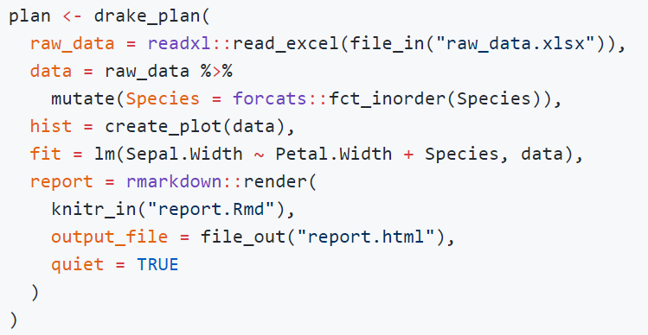
Example

Slide 11
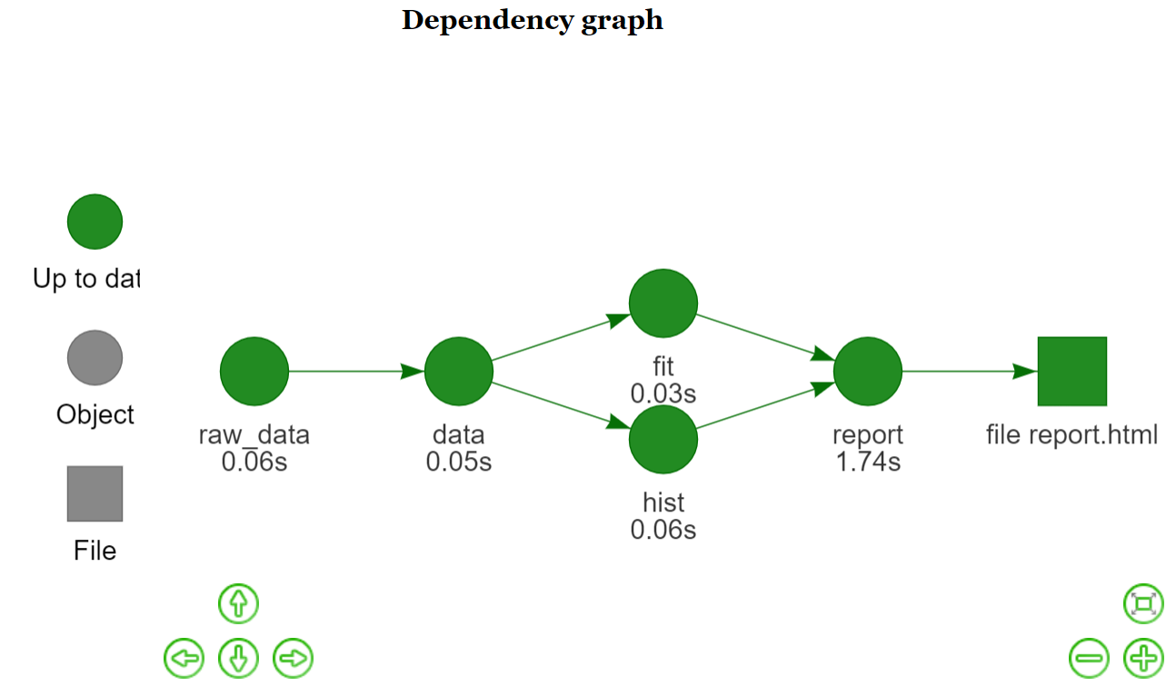
After drake build
Notes:
… all dots are green, indicating targets are up to date

Slide 12
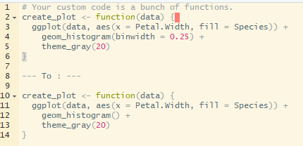
What happens when we alter a function

Slide 13
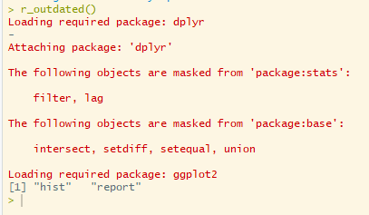
What happens when we alter a function?
Running `r_outdated` tells you that because of your change, the listed targets need to be rebuilt.

Slide 14
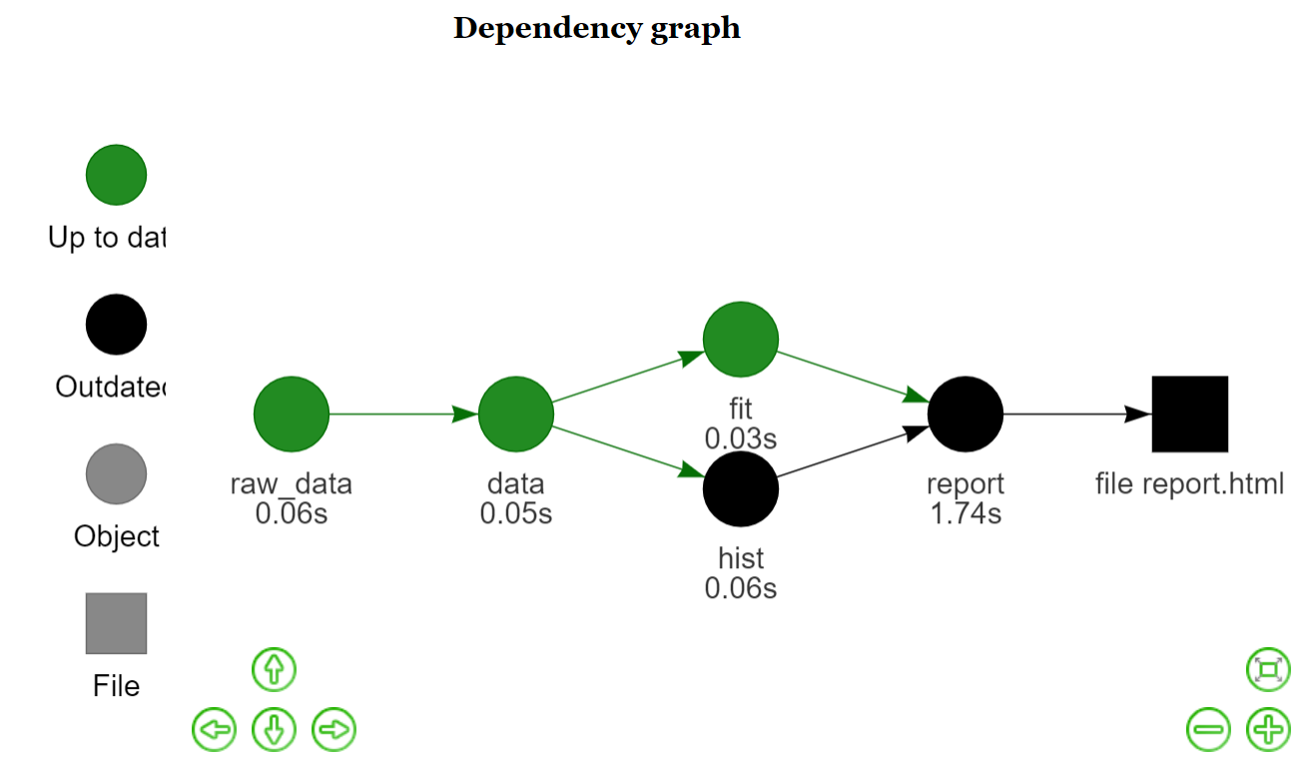
What happens when we alter a function?
Black icons indicate the out-of-date objects that need to be re-created.

Slide 15
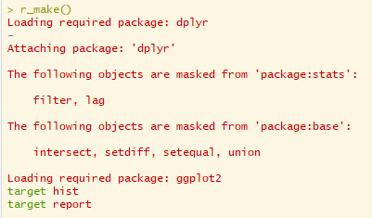
What happens when we alter a function?
Re-running `r_make()` runs *just* the necessary functions to propagate the changes.
Notes:
… you can see the two targets that need rerunning are rerun...

Slide 16
What happens when we alter a function?
Graph is now back up to date.
Notes:
… all dots are green, indicating targets are up to date

Slide 17
Resources
Git repo for drake project: https://github.com/ropensci/drake
Drake manual: https://ropenscilabs.github.io/drake-manual/
Similar piepline tools, many languages: https://github.com/pditommaso/awesome-pipeline
Learn drake repo for self-tutorial: https://github.com/wlandau/learndrake
Other presentations: https://ropenscilabs.github.io/drake-manual/index.html#presentations

Slide 18
Thank You
Matt Pettis
Email: matthew.pettis@gmail.com
Gitlab: mpettis
Twitter: @mtpettis

